Slide 1
Hardware Experimentation
Interactive Media
Unit 1

Slide 2
Starter – As you log in
On your whiteboards: Answer the following question.
What pieces of hardware have you used for this portfolio so far?

Slide 3
Learning Outcomes
Understand why we use different hardware for different jobs.
Describe the different types of peripherals used.
Explain which hardware is best for certain tasks.

Slide 4
Evidence of Hardware
The final bullet point of LO2 explains that you are required to give evidence for the different hardware you have used.
For most (or all) of the experimentation so far, you will have used the school computers.
Each computer in CL3 has the same specifications.

Slide 5
School PC – Specifications
Model:
Dell Optiplex 2040 SFF
CPU:
Intel Core i5-6500 @ 3.20GHz
RAM:
16GB Dual Channel DDR3L @ 1600MHz
Graphics:
Intel HD Graphics 530
Storage:
256GB SSD

Slide 6
Task 1 - School PC Hardware
Add a new heading to your portfolio Hardware Experimentation (Heading 1).
Add another heading, School PC (Heading 2).
Using the CPU-Z software found on the Files tab of your Team, take a screenshot of the specs for the school computers. Paste this screenshot below the School PC heading.
In a couple of sentences, explain why you used this hardware at school and explain any problems you had with the school PC.

Slide 7
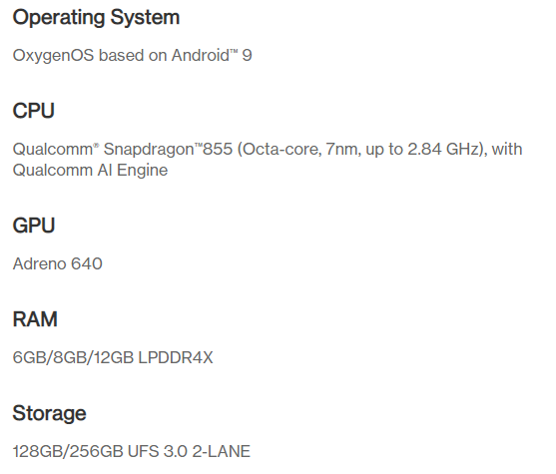
Task 2 – Phone Hardware
Add a new heading to your portfolio Personal Phone (Heading 2).
Write down the make and model of your phone, e.g. OnePlus 7Pro.
Using the internet, get a screenshot of the specifications for your phone, try and include the CPU, GPU, RAM and Operating System.
Explain what experimentation you used for phone for as part of the coursework. If you didn’t use your phone at all, explain why you didn’t use it.

Slide 8
Peripherals
Peripherals are any of the devices you connect to a computer to allow it to input and/or output data.
For example, you have all used a mouse, keyboard and monitor with the school computers.
Try and think of any other devices you use connected to your home computers.

Slide 9
Task 3 - Peripherals
Add a new heading to your portfolio, Peripherals, (Heading 2).
List each of the peripherals you have used as part of experimentation, e.g.
Mouse
Keyboard
Monitor
Speaker/Headphones
For each peripheral, explain what it does and why you used it (even if it is a little obvious!)

Slide 10
Other Hardware
As part of your experimentation, did you notice the computers running slower than you would have liked at any point? Is your home computer faster?
When using a specific piece of software, did you find that it might have been easier with different peripherals?
Would a graphics tablet or camera help with Photoshop?

Slide 11
Task 4 – Unused Hardware
Add a new heading to your portfolio, Unused Hardware (Heading 2).
List 5+ pieces of different hardware or peripherals you could have used as part of the experimentation.
Try and think of what could be improved about the existing hardware and peripherals.
How would you improve the monitor?
Would a keyboard with macro buttons help?
Would a better CPU help?
For each of the above, explain how it would have been helpful/better if you’d have been able to use it for your coursework.

